Slide 1

Department
of COMPUTER SCIENCE
&
ENGINEERING
Course Name : Design Project -1 Course Code : CSB 4243
Team No : 6
Team Members :
Ruben Varghese
Arun N

Slide 2
SOFTWare for a self sustaining farm

Slide 3

MEET OUR TEAM
Ruben
Varghese
Arun N
21113051
21113046

Slide 4
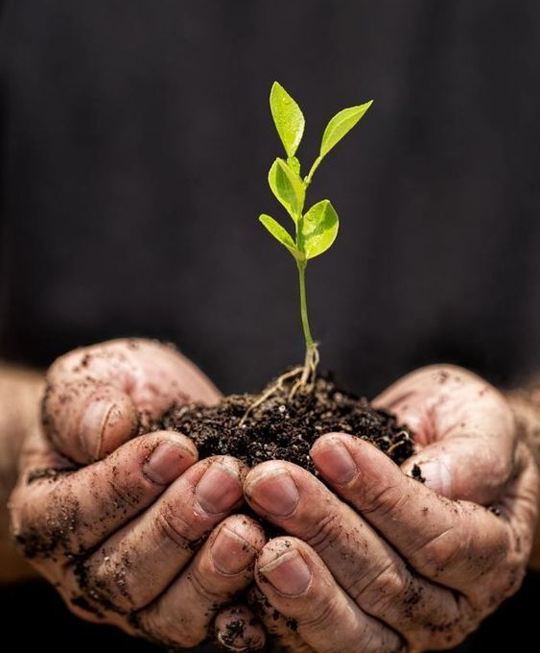
Content
INTRODUCTION
Description
Literature Review
Advantages
disadvantages
SUMMARY

Slide 5
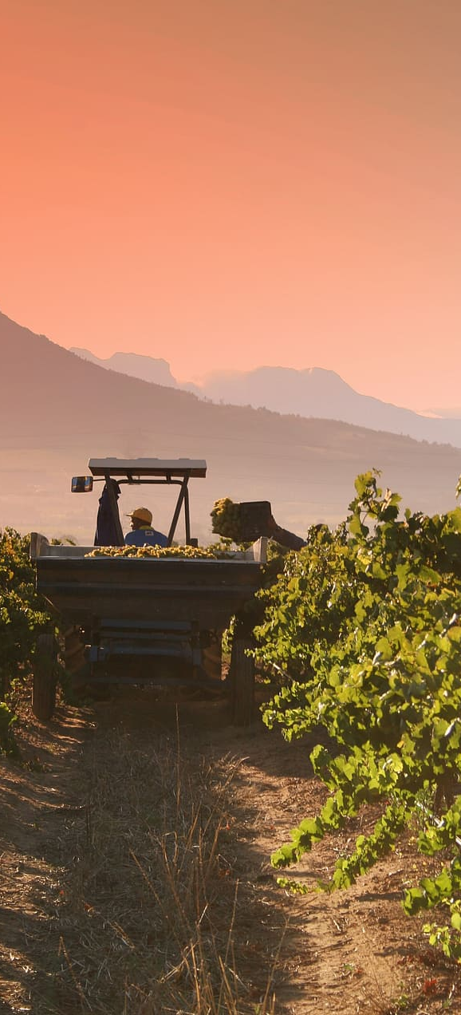
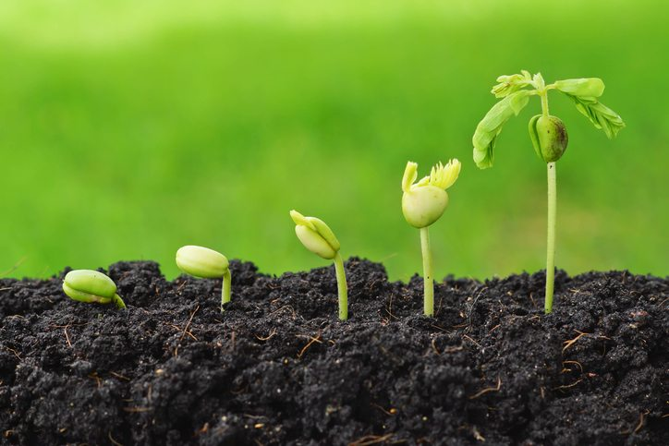
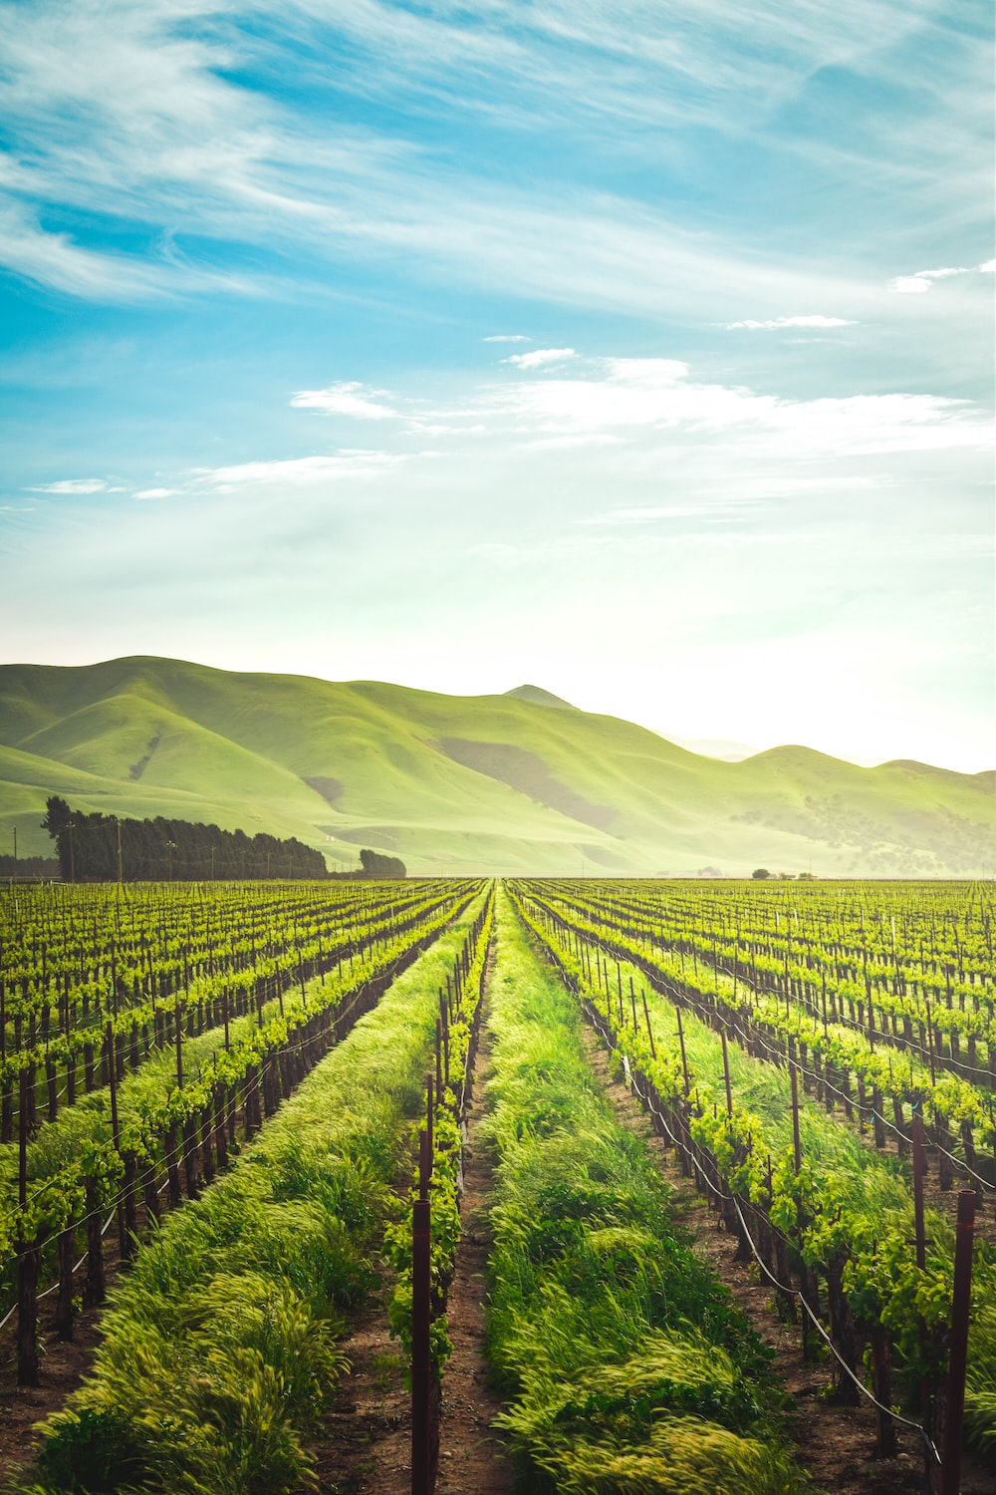
The discovery of agriculture was the first big step towards civilized life.
“
”
- Arthur Keith

Slide 6
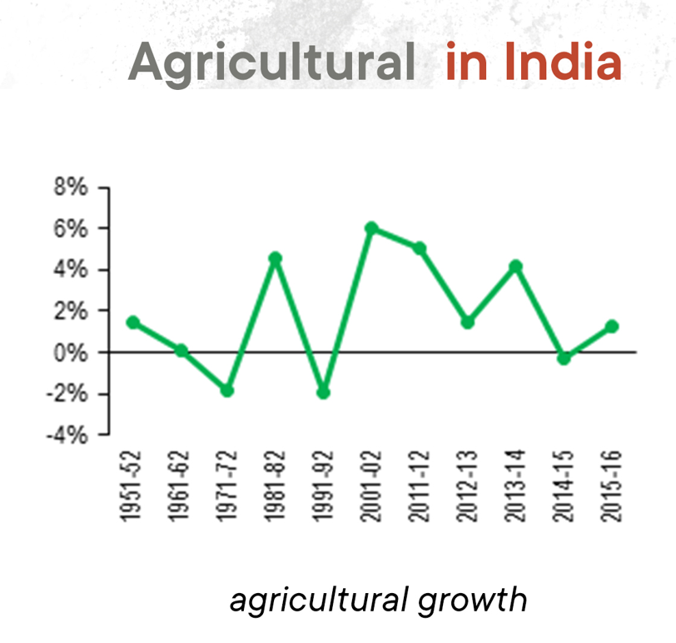
INTRO
Agriculture in India is not a mere profession but a culture, tradition to be practiced by one and all. Agriculture is the biggest industry in India, and it also plays a key role in the socio-economic growth of the country. Agriculture has been the strongest and the foundational culture of India.
From festivals being celebrated according to the farming calendar (Pongal, Onam) and the monsoon cycle to weddings and marriages in families, agriculture has played a huge role on it all. But now, disassociation from tradition.

Slide 7
THEME
Agriculture, foodtech and rural development

Slide 8
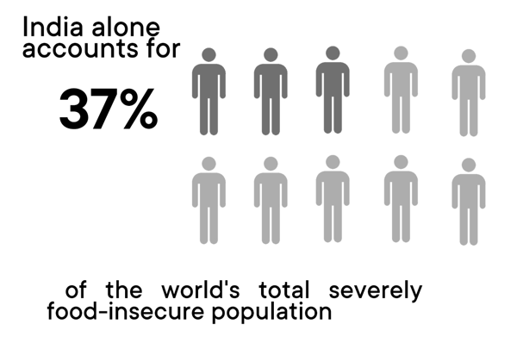




DESCRIPTION
Agricultural Transition Globally
Early Agriculture
Over Centuries, the growth of agriculture
contributed to the rise of civilizations. Domestication, breeding, traditional farming methods.
Organic, healthy lifestyle, less population.
Industrial Agriculture
With increase in land degradation, threat to agricultural land, increased water usage, ecological issues, food insecurity.
Agriculture Boom – Mass Production
For thousands of years farmers relied on natural fertilizers – materials such as manure, wood ash, ground bones, fish. In the early 1800s, as demand due to population explosion this led to the use of chemical fertilizers.
Organic Movement
With increase in land degradation, threat to agricultural land, increased water usage, ecological issues, food insecurity.

Slide 9
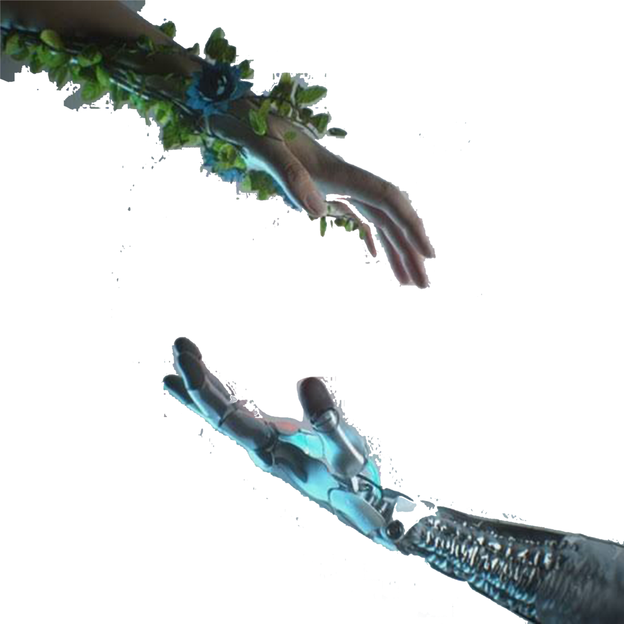
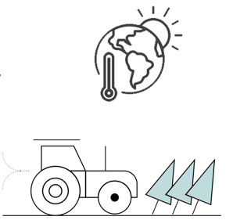
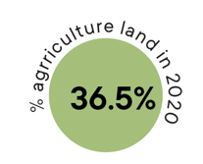
The traditional way of farming cannot be eradicated but practicing it with scientific technology can help in production and it should be one of the agenda for a scientist. Development in agriculture in India is very important as our economy depends upon it. The resources are limited so it is important to use both traditional as well as scientific approaches smartly so that productivity of crops can be improved with the utilization of scarce resources.
Agriculture
Technology
This activity produces greatest deforestation and loss of biodiversity.
Agriculture is a major part of the climate problem

Slide 10

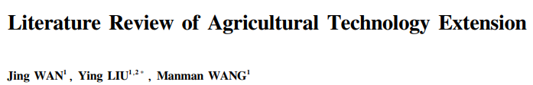
Literature review
Overview of agricultural technology extension
History and current situation
Researches
Data and methods
Theoretical Research
Conclusions and policy recommendations

Slide 11
Literature review table
S.NO | TITLE OF THE PAPER | AUTHORS | PUBLICATION (NAME OF THE JOURNAL/CONFERENCE PROCEEDINGS WITH YEAR) | ALGORITHM/METHODOLOGY ADOPTED | LIMITATIONS
1. | A Review on Technology Adoption in Precision Agriculture: The Behavior and Use Acceptance | Andi Wiliam | A Review on Technology Adoption in Precision Agriculture: The Behavior and Use Acceptance was written by Andi Wiliam and was published in the “Journal of A Review on Technology Adoption in Precision Agriculture: The Behavior and Use Acceptance.” in 2022 The publication venue,” ICIT 2021: 2021 The 9th International Conference on Information Technology: IoT and Smart City” The literature focuses on Agricultural Technology development. And was released in 2022 | Plan the Review: Start by Planning the analysis with the following activities Conducting the analysis Conduct the Review The first step was completed, and 196 papers were extracted using parameters that applied to the analysis in answering the research question, which was classified in a section called "Studies Found." | This limitation applies to model comparison studies also. Our work tracks participants through various stages of experience with a new technology and compares all models on all participants. There are still many areas that need to be developed in this study.

Slide 12
S.NO | TITLE OF THE PAPER | AUTHORS | PUBLICATION (NAME OF THE JOURNAL/CONFERENCE PROCEEDINGS WITH YEAR) | ALGORITHM/METHODOLOGY ADOPTED | LIMITATIONS
2. | Drones in agriculture: A review and bibliometric analysis. | Abderahman Rejeb Alireza Abdollahi, Karim Rejeb,Horst Treiblmaier | A Review on Drones in agriculture was written by Abderahman Rejeb Alireza Abdollahi, Karim Rejeb,Horst Treiblmaier and was published in the “Drones in agriculture: A review and bibliometric analysis .” in 2022 The publication venue,” https://www.sciencedirect.com/science/article/pii/S0168169922003349?via%3Dihub” And was released in 2022 | In this current research study, Generally, a bibliometric analysis examines the extant literature to summarize and uncover hidden patterns of written communication and the evolution of the discipline based on statistics and mathematical methods, and it applies to large data sets.By using bibliometrics, we aspire to better understand the existing paradigms and research foci that contribute to the domain based on similarity. | Our study has several limitations. Firstly, the findings are determined by the publications selected for the final analysis. It is challenging to capture all relevant studies related to agricultural drones, particularly those not indexed in the Scopus database. Further, the data collection process is limited to the setting of search keywords, which may not be inclusive and lead to inconclusive findings.

Slide 13
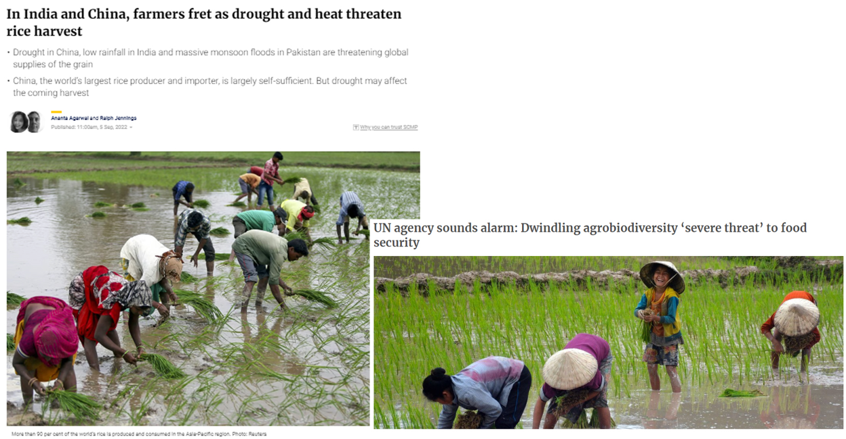
Articles

Slide 14
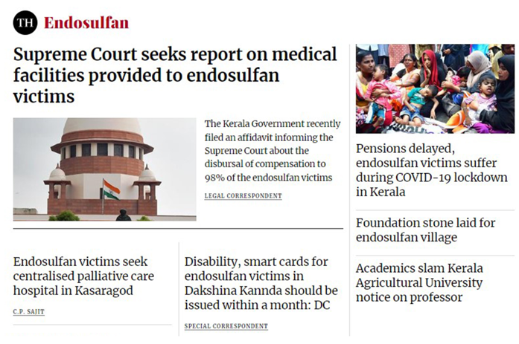
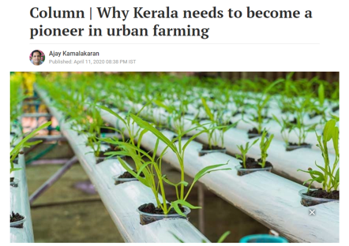
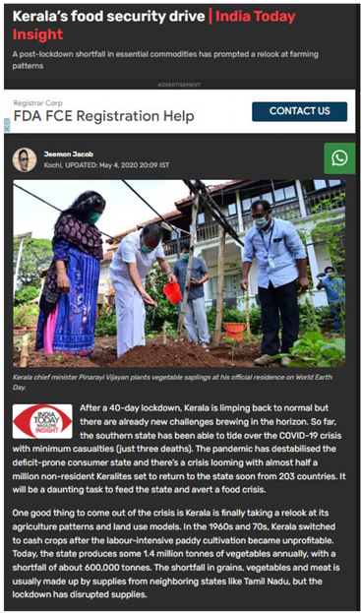
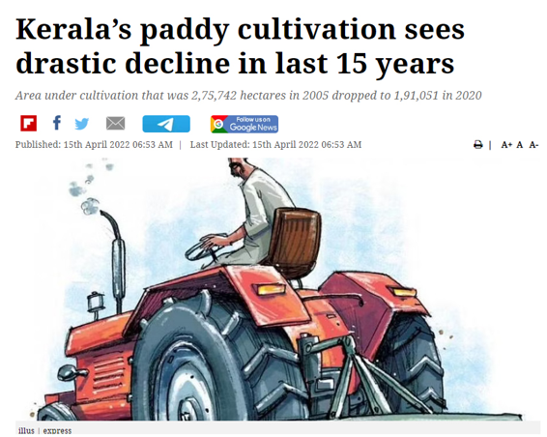
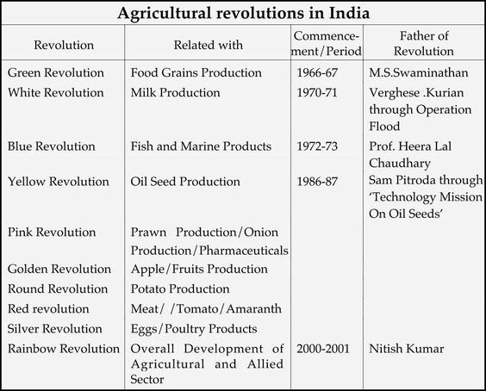

Slide 15
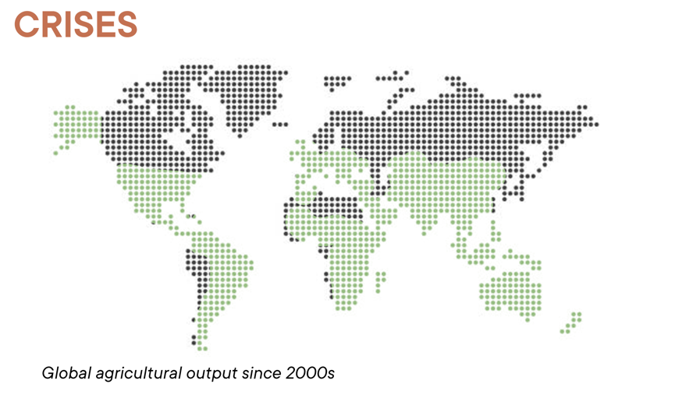

Slide 16
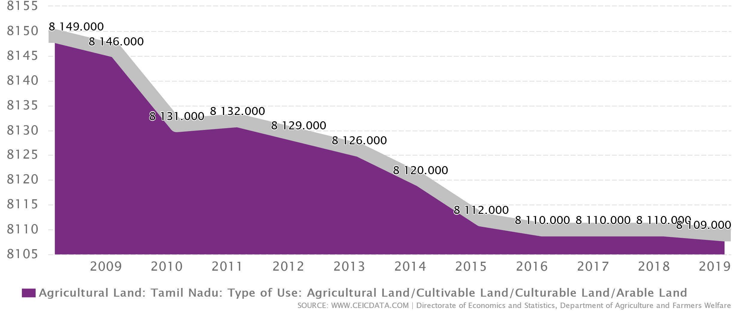
Agriculture decline in Tamil nadu

Slide 17
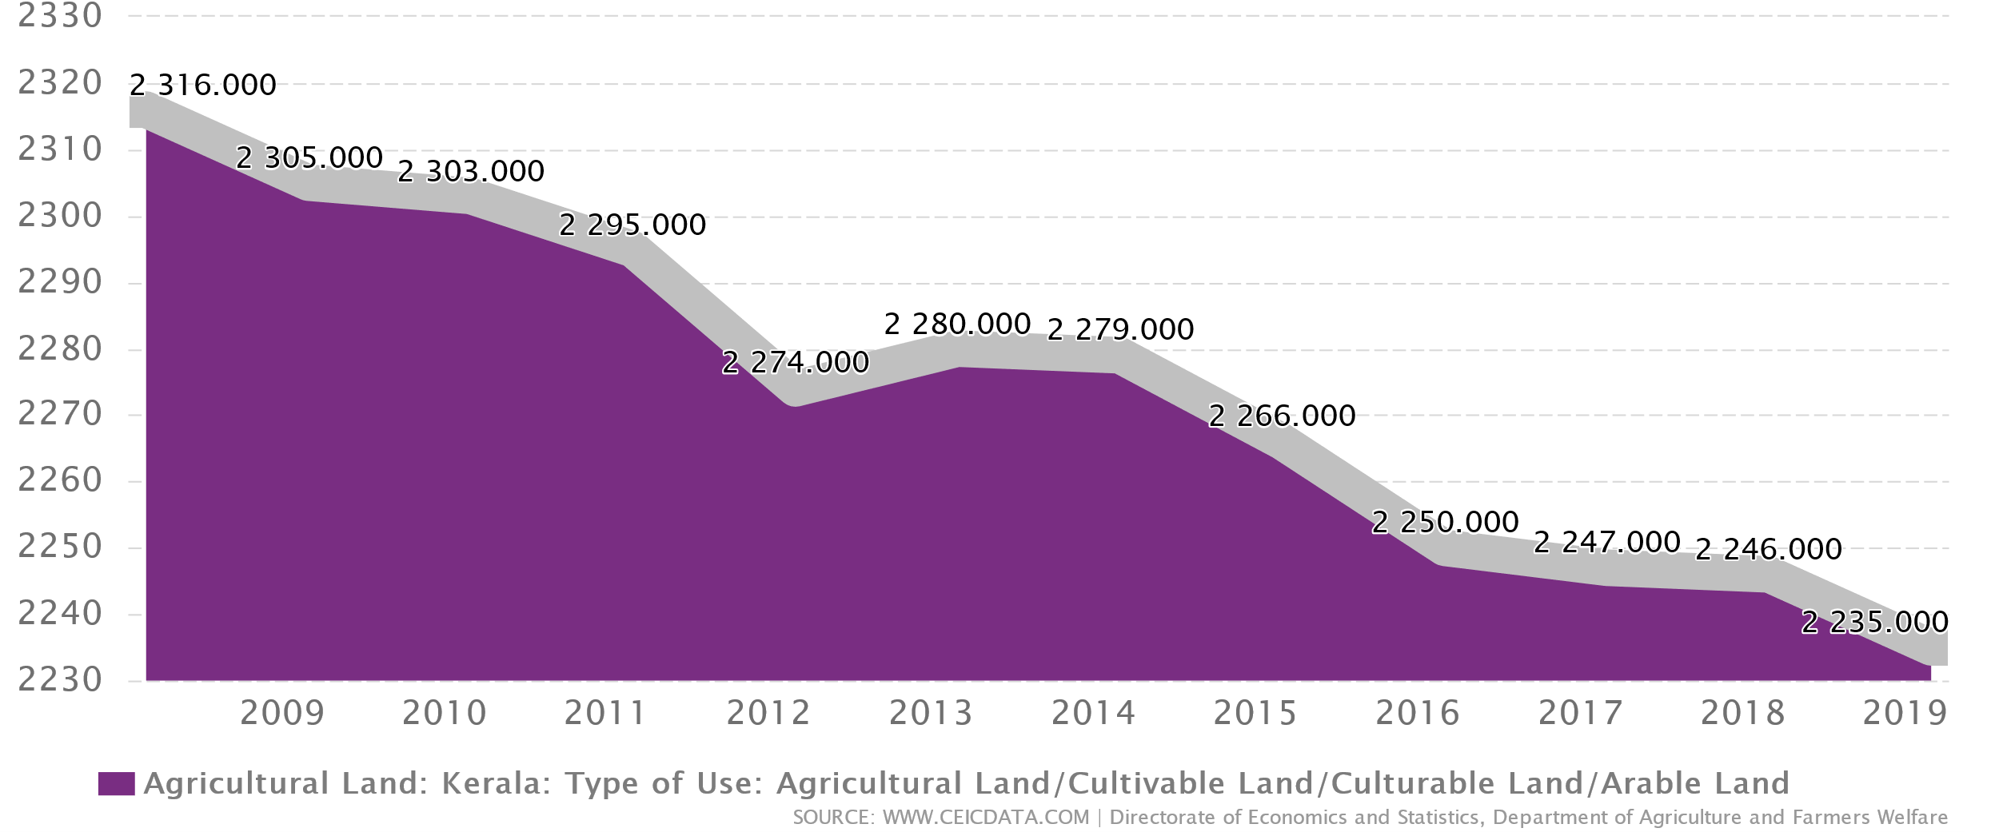
Agriculture decline in kerala

Slide 18
System requirements
There are many types of IoT sensors for agriculture as well as IoT applications in agriculture in general:
Monitoring of climate conditions.
Greenhouse automation.
Crop management.
Cattle monitoring and management.
Precision farming.

Slide 19
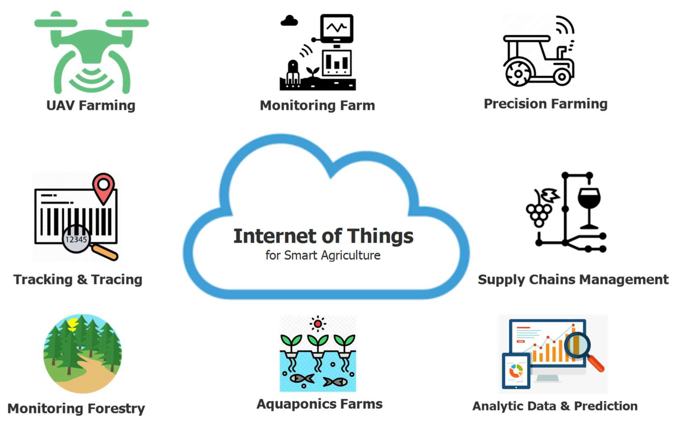
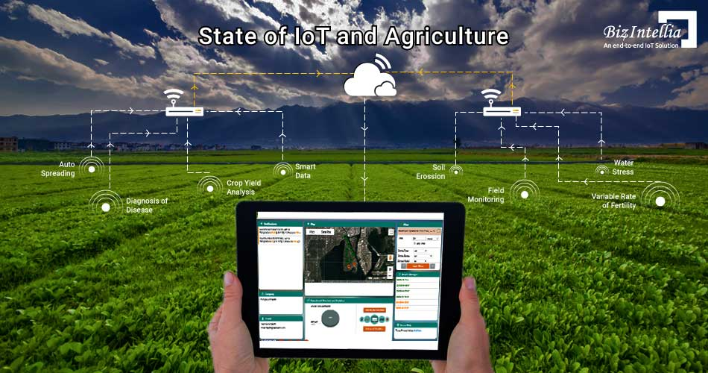
Agricultural drones.
Predictive analytics for smart farming.
Airflow Sensors
Electrochemical Sensors For Soil Nutrient Detection.
And other Electronic Sensors…

Slide 20
Existing Systems
IoT in agriculture uses robots, drones, remote sensors, and computer imaging combined with continuously progressing machine learning and analytical tools for monitoring crops, surveying, and mapping the fields, and providing data to farmers for rational farm management plans to save both time and money.

Slide 21
Disadvantages
Current World Population - 8 Billion
Food Insecurity
Rapid Urbanization
Agricultural Threat
Climate Change - Heat waves , Drought and Saline intrusion
Higher Food Production
CO2 Emissions during Transportation

Slide 22
Proposed systems
Precision Farming : The world is moving towards sustainable agriculture to reduce its carbon footprint.
Smart Greenhouses.
Next Generation Vertical Farming.
Hydroponics, Aquaponics and Aeroponics.
Farming software and online data.
AI and Machine Learning Algorithms

Slide 23
ADVANTAGES
Higher Crop Productivity (40 to 60 times more yield)
Decreased use of water, fertilizer, and pesticides, which in turn keeps food prices down
Reduced impact on natural ecosystems
Increased worker safety and minimum manpower
Less runoff of chemicals into rivers and groundwater
100% Natural Product

Slide 24
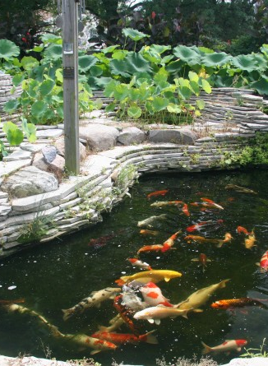
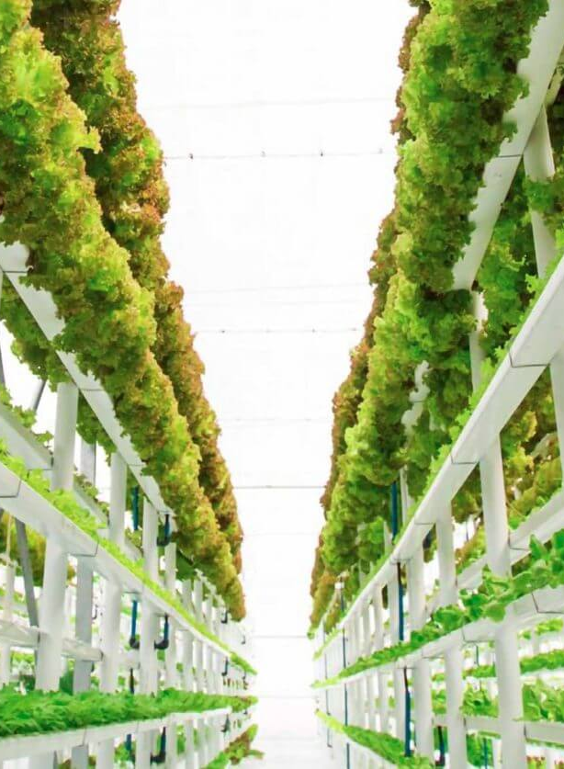
SOLUTION
technology
Artificial Intelligence (AI)
The Internet of Things (IoT)​
Generative Design
agriculture
Vertical Farming
Aquaponics, Hydroponics and Aeroponics
Controlled – Environment Agriculture

Slide 25
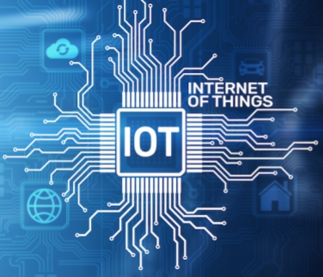
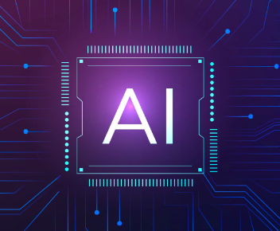
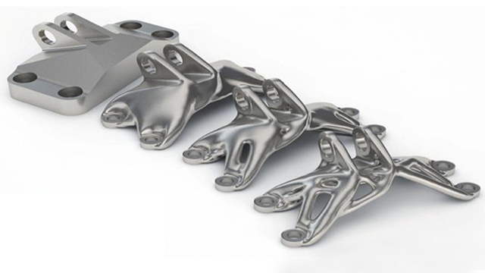
HOW WE GET THERE
IOT
AI
Generative Design
Internet of Things
Network of Physical Objects
Embedded with sensors, software and other technologies
Artificial Intelligence
Problem solving and decision-making capabilities
Iterative Design Process
Performance or spatial requirements, materials, manufacturing methods and cost constraints

Slide 26
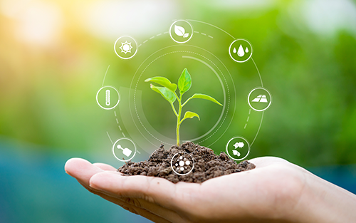
SUMMARY
Today's agriculture routinely uses sophisticated technologies such as robots, temperature and moisture sensors, aerial images, and GPS technology. These advanced devices and precision agriculture and robotic systems allow businesses to be more profitable, efficient, safer, and more environmentally friendly.

Slide 27

References
Google Chrome
MDPI
Smart Farming: Internet of Things (IoT)-Based Sustainable Agriculture
By Muthumanickam Dhanaraju, Poongodi Chenniappan, Kumaraperumal Ramalingam, Sellaperumal Pazhanivelan and Ragunath Kaliaperuma.
Received: 7 September 2022 / Revised: 11 October 2022 / Accepted: 12 October 2022 / Published: 21 October 2022

Slide 28
THANK YOU
Project Members
Arun N
Ruben Varghese

